Slide 1
Relational Algebra and Relational Calculus LECTURER: Olivier Kevin ISHIMWE Email: kishimwe@uok.ac.rw

Slide 2
Objectives
Meaning of the term relational completeness.
How to form queries in relational algebra.
How to form queries in tuple relational calculus.
How to form queries in domain relational calculus.
Categories of relational DML.

Slide 3
Introduction
Relational algebra and relational calculus are formal languages associated with the relational model.
Informally, relational algebra is a (high-level) procedural language and relational calculus a non-procedural language.
However, formally both are equivalent to one another.
A language that produces a relation that can be derived using relational calculus is relationally complete.

Slide 4
Relational Algebra
Relational algebra operations work on one or more relations to define another relation without changing the original relations.
Both operands and results are relations, so output from one operation can become input to another operation.
Allows expressions to be nested, just as in arithmetic. This property is called closure.

Slide 5
Relational Algebra
Five basic operations in relational algebra: Selection, Projection, Cartesian product, Union, and Set Difference.
These perform most of the data retrieval operations needed.
Also have Join, Intersection, and Division operations, which can be expressed in terms of 5 basic operations.

Slide 6
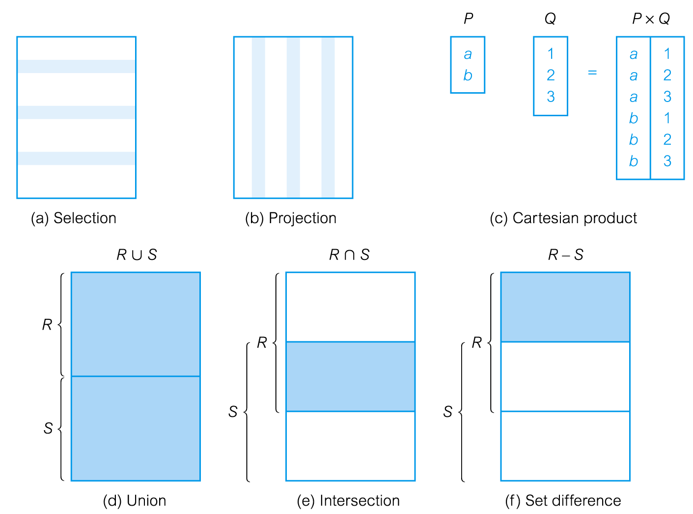
Relational Algebra Operations

Slide 7
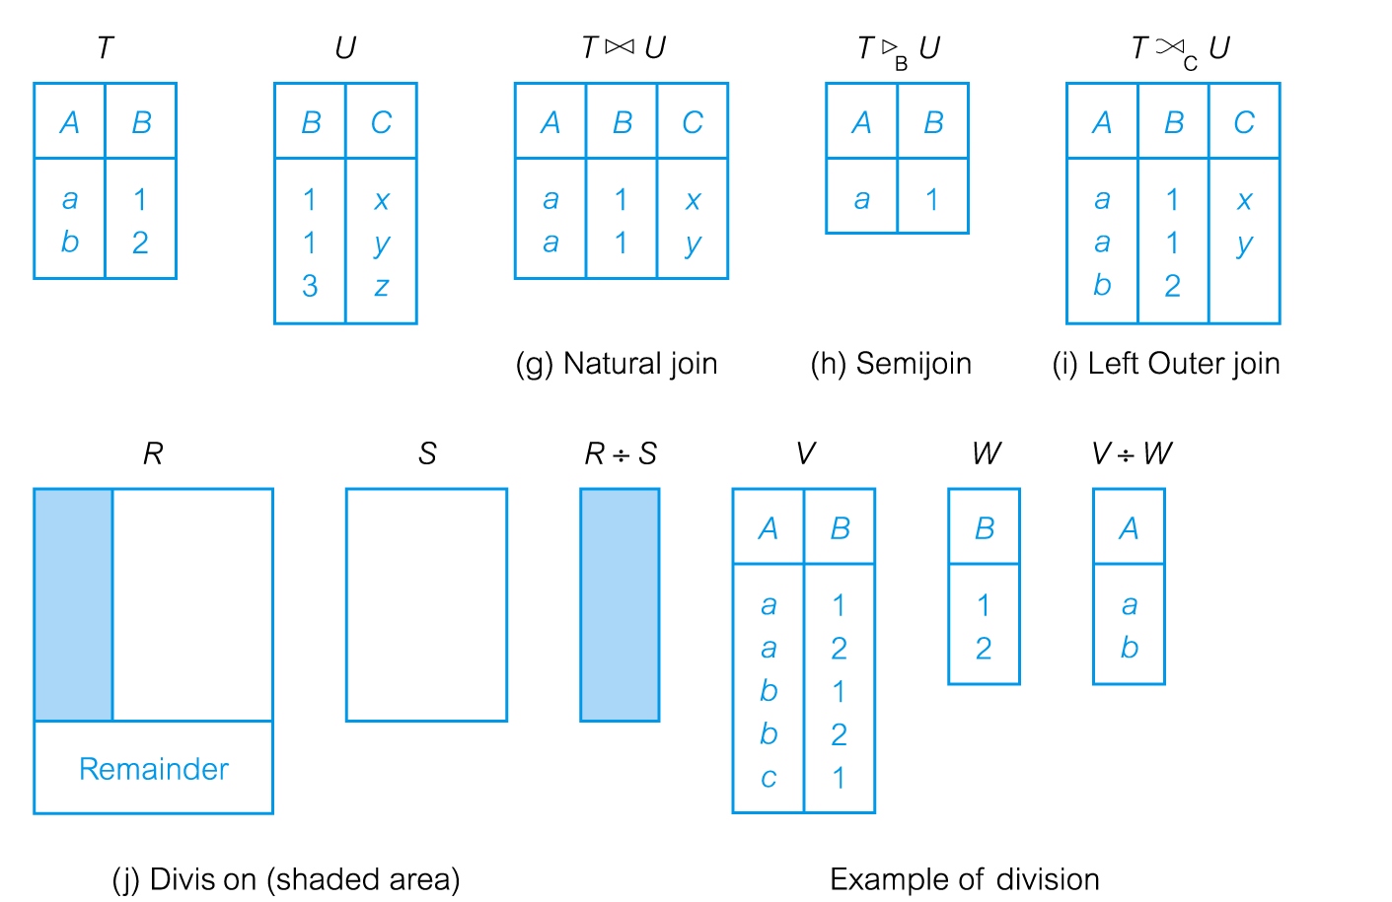
Relational Algebra Operations

Slide 8
Selection (or Restriction)
σ_{predicate} (R)
Works on a single relation R and defines a relation that contains only those tuples (rows) of R that satisfy the specified condition (predicate).

Slide 9
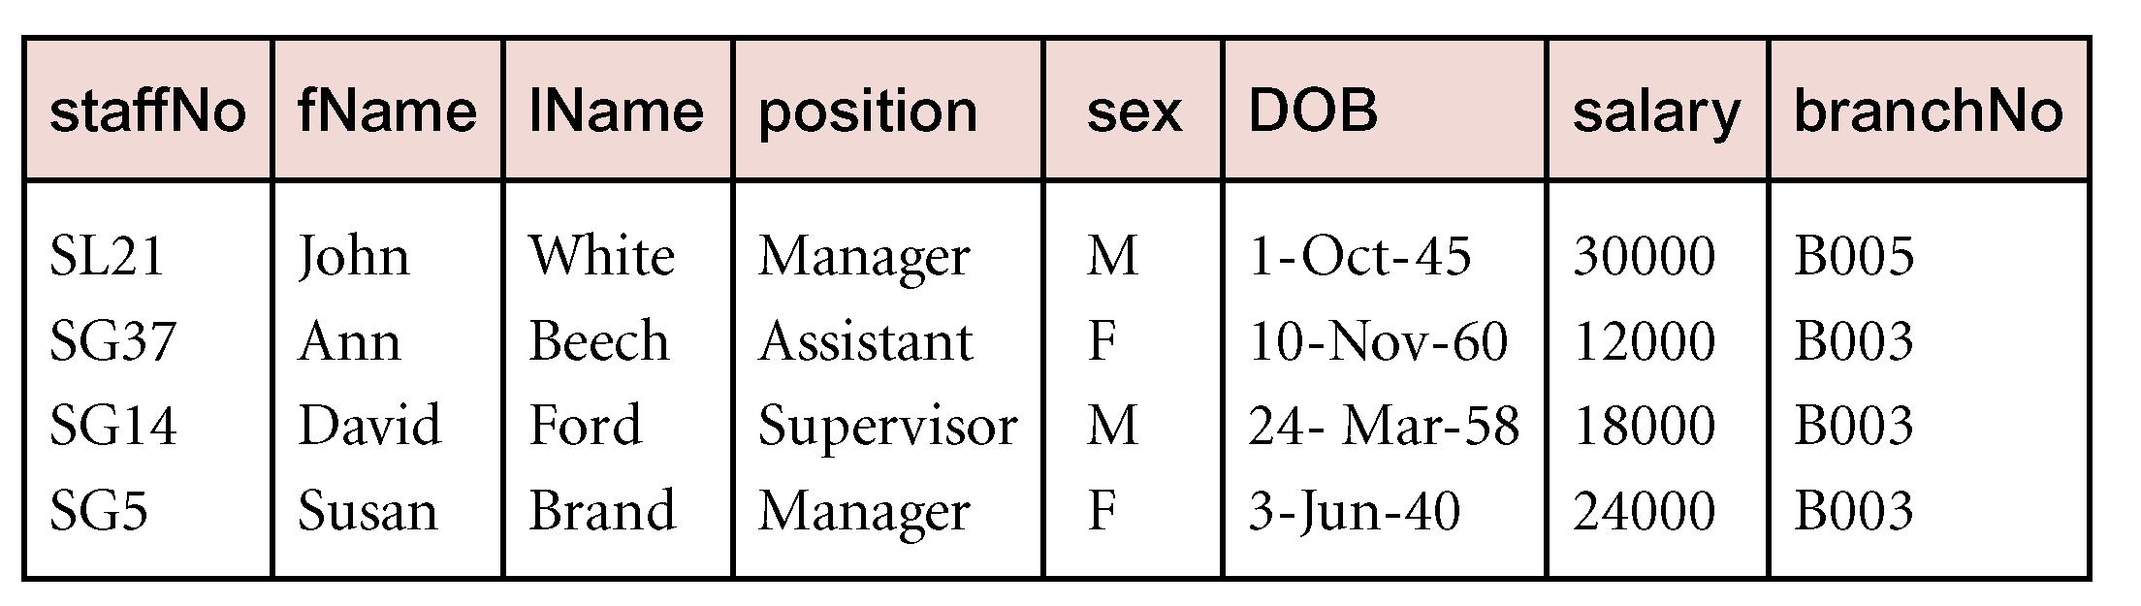
Example - Selection (or Restriction)
List all staff with a salary greater than £10,000.
σ_{salary > 10000} (Staff)

Slide 10
Projection
Π_{col1, . . . , coln}(R)
Works on a single relation R and defines a relation that contains a vertical subset of R, extracting the values of specified attributes and eliminating duplicates.

Slide 11
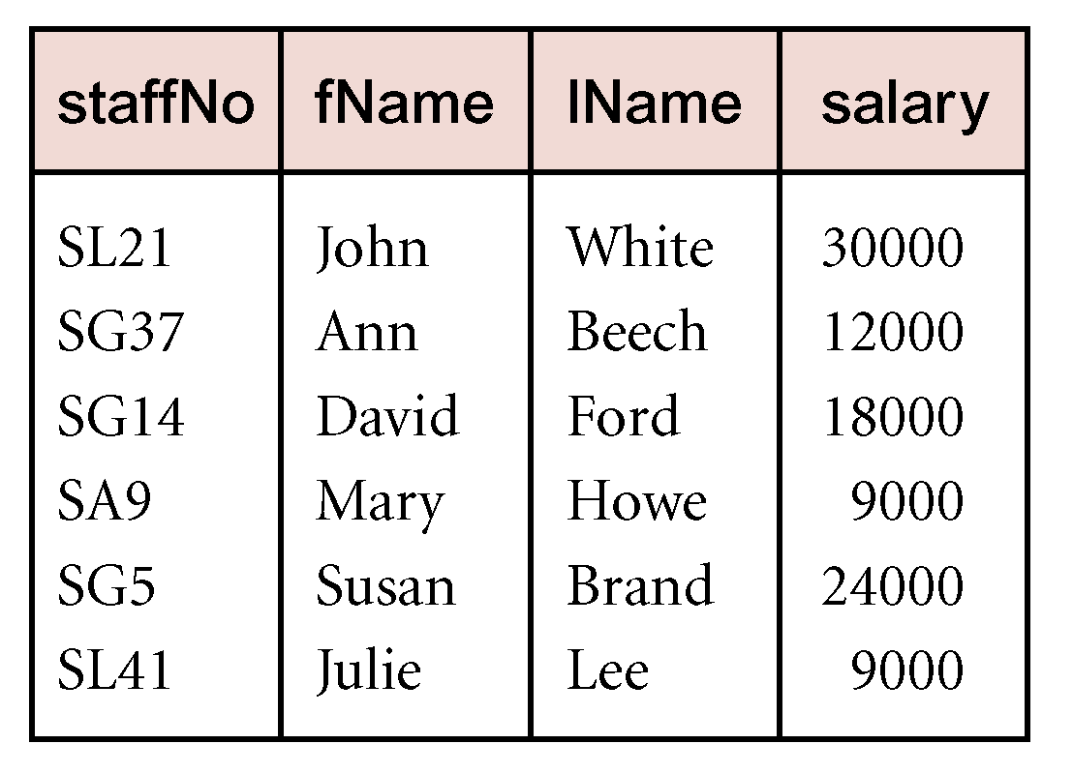
Example - Projection
Produce a list of salaries for all staff, showing only staffNo, fName, lName, and salary details.
Π_{staffNo, fName, lName, salary}(Staff)

Slide 12
Union
R ∪ S
Union of two relations R and S defines a relation that contains all the tuples of R, or S, or both R and S, duplicate tuples being eliminated.
R and S must be union-compatible.
If R and S have I and J tuples, respectively, union is obtained by concatenating them into one relation with a maximum of (I + J) tuples.

Slide 13
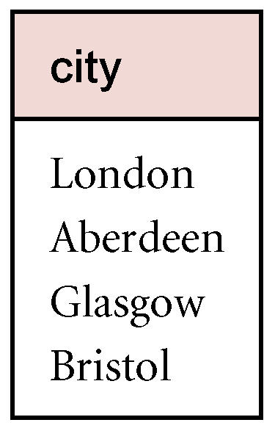
Example - Union
List all cities where there is either a branch office or a property for rent.
Π_{city}(Branch) ∪ Π_{city}(PropertyForRent)
Pearson Education © 2009

Slide 14
Set Difference
R – S
Defines a relation consisting of the tuples that are in relation R, but not in S.
R and S must be union-compatible.
Pearson Education © 2009

Slide 15
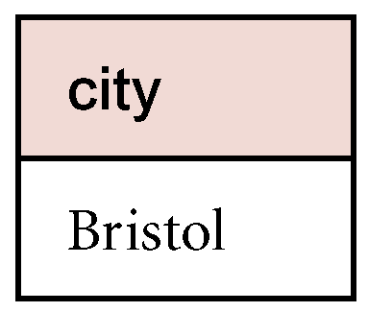
Example - Set Difference
List all cities where there is a branch office but no properties for rent.
Π_{city}(Branch) – Π_{city}(PropertyForRent)
Pearson Education © 2009

Slide 16
Intersection
R ∩ S
Defines a relation consisting of the set of all tuples that are in both R and S.
R and S must be union-compatible.
Expressed using basic operations:
R ∩ S = R – (R – S)

Slide 17
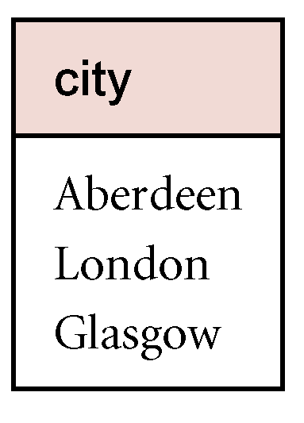
Example - Intersection
List all cities where there is both a branch office and at least one property for rent.
Π_{city}(Branch) ∩ Π_{city}(PropertyForRent)

Slide 18
Cartesian product
R X S
Defines a relation that is the concatenation of every tuple of relation R with every tuple of relation S.

Slide 19
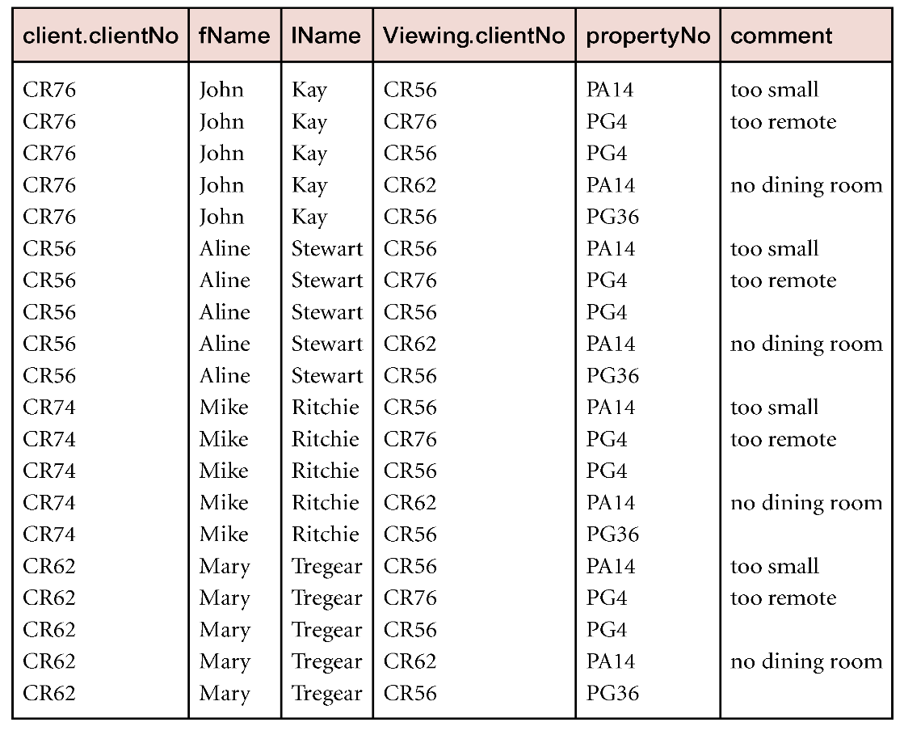
Example - Cartesian product
List the names and comments of all clients who have viewed a property for rent.
(Π_{clientNo, fName, lName}(Client)) X (Π_{clientNo, propertyNo, comment} (Viewing))

Slide 20
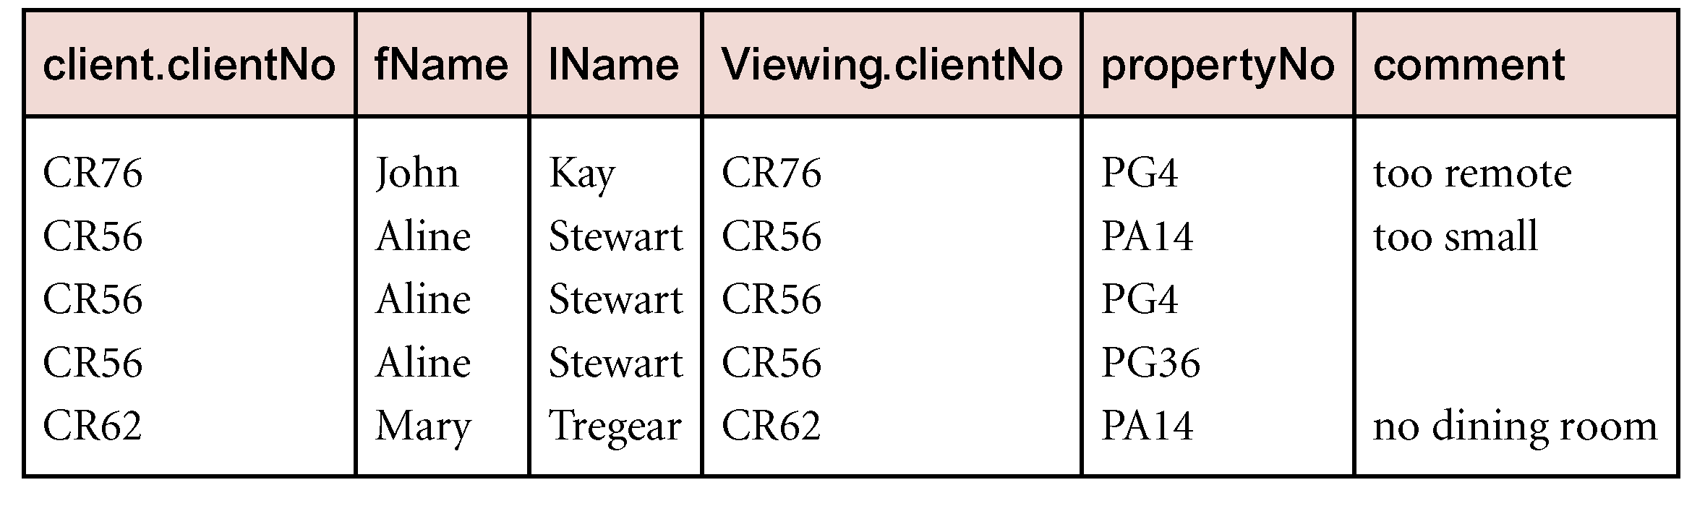
Example - Cartesian product and Selection
Use selection operation to extract those tuples where Client.clientNo = Viewing.clientNo.
σClient.clientNo = Viewing.clientNo((∏_{clientNo, fName, lName}(Client)) Χ (∏_{clientNo, propertyNo, comment}(Viewing)))
Cartesian product and Selection can be reduced to a single operation called a Join.

